Slide 1
Introduction to Data Science
José Manuel Calderón Trilla
(slides by John P. Dickerson)
Lecture #2 – 01/27/2020
CMSC320
Mondays & Wednesdays
5:00pm – 6:15pm (… or anytime on the Internet)
Notes:
<number>

Slide 2
Announcements
Register on Discord:
110 have registered already
The rest have not
If you were on Discord, you’d know …
Project 0 is out! It is “due” next Wednesday evening.
Link: https://github.com/cmsc320/spring2021/tree/main/project0
We’ve also linked some reading for the week!
First quiz will be due Monday at noon.
Quiz will go up tomorrow (Thursday)
2

Slide 3
(A few) Data Science Success Stories & Cautionary Tales
3

Slide 4
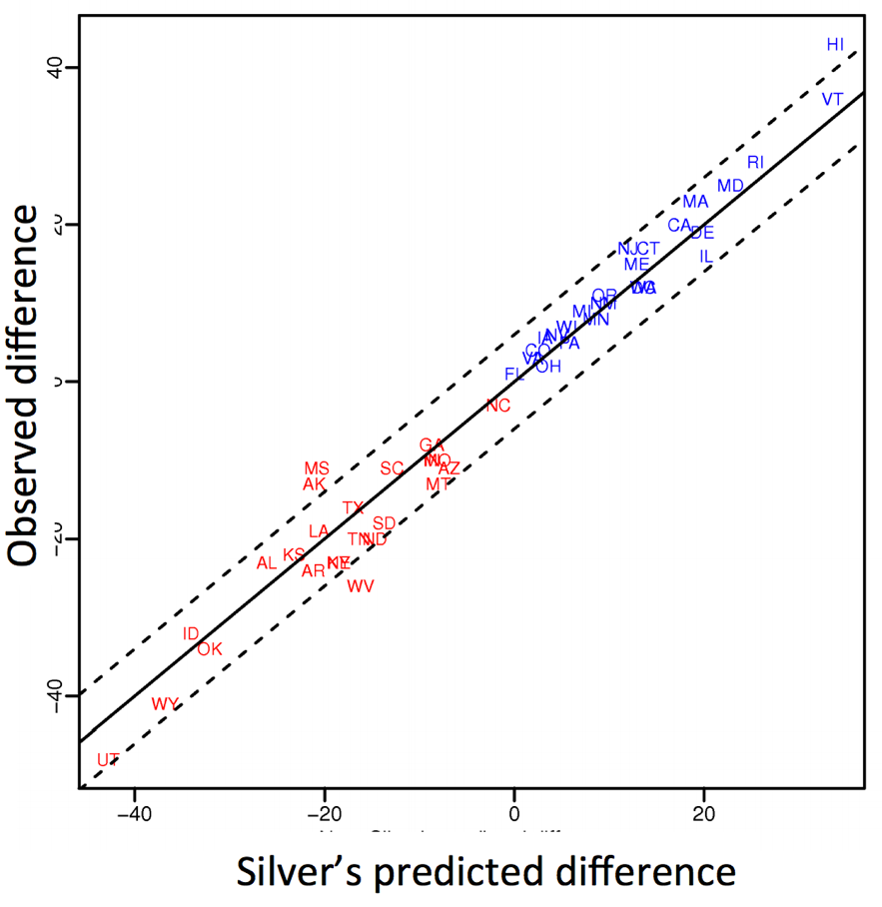
Polling: 2008 & 2012
Nate Silver uses a simple idea – taking a principled approach to aggregating polling instead of relying on punditry – and:
Predicts 49/50 states in 2008
Predicts 50/50 states in 2012
(He is also a great case study in creating a brand.)
https://hbr.org/2012/11/how-nate-silver-won-the-2012-p
3
Democrat (+) or Republican (-) in 2012

Slide 5
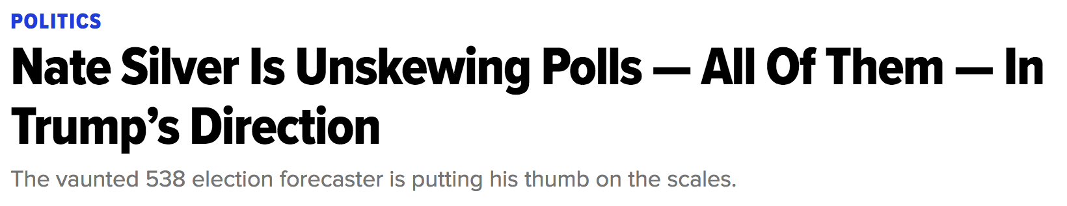
Polling: 2016
HuffPo: “He may end up being right, but he’s just guessing. A “trend line adjustment” is merely political punditry dressed up as sophisticated mathematical modeling.”
538: Offers quantitative reasoning for re-/under-weighting older polls, & changing as election approaches
5
http://www.huffingtonpost.com/entry/nate-silver-election-forecast_us_581e1c33e4b0d9ce6fbc6f7f
https://fivethirtyeight.com/features/a-users-guide-to-fivethirtyeights-2016-general-election-forecast/

Slide 6
Ad Targeting
Pregnancy is an expensive & habit-forming time
Thus, valuable to consumer-facing firms
2012:
Target identifies 25 products and subsets thereof that are commonly bought in early pregnancy
Uses purchase history of patrons to predict pregnancy, targets advertising for post-natal products (cribs, etc)
Good: increased revenue
Bad: this can expose pregnancies – as famously happened in Minneapolis to a high schooler
5
http://www.businessinsider.com/the-incredible-story-of-how-target-exposed-a-teen-girls-pregnancy-2012-2
Notes:
<number>

Slide 7









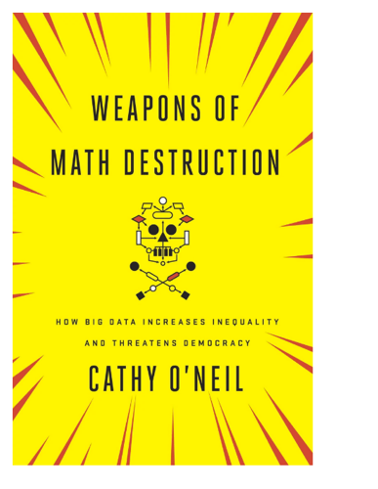
Automated decisions of consequence
[Sweeney 2013, Miller 2015, Byrnes 2016,
Rudin 2013, Barry-Jester et al. 2015]
Hiring
Lending
Policing/
sentencing
Search for minority names →
ads for DUI/arrest records
Female cookies →
less freq. shown professional job opening ads
7

Slide 8
“… a lot remains unknown about how big data-driven decisions may or may not use factors that are proxies for race, sex, or other traits that U.S. laws generally prohibit from being used in a wide range of commercial decisions … What can be done to make sure these products and services–and the companies that use them treat consumers fairly and ethically?”
- FTC Commissioner Julie Brill [2015]
7

Slide 9
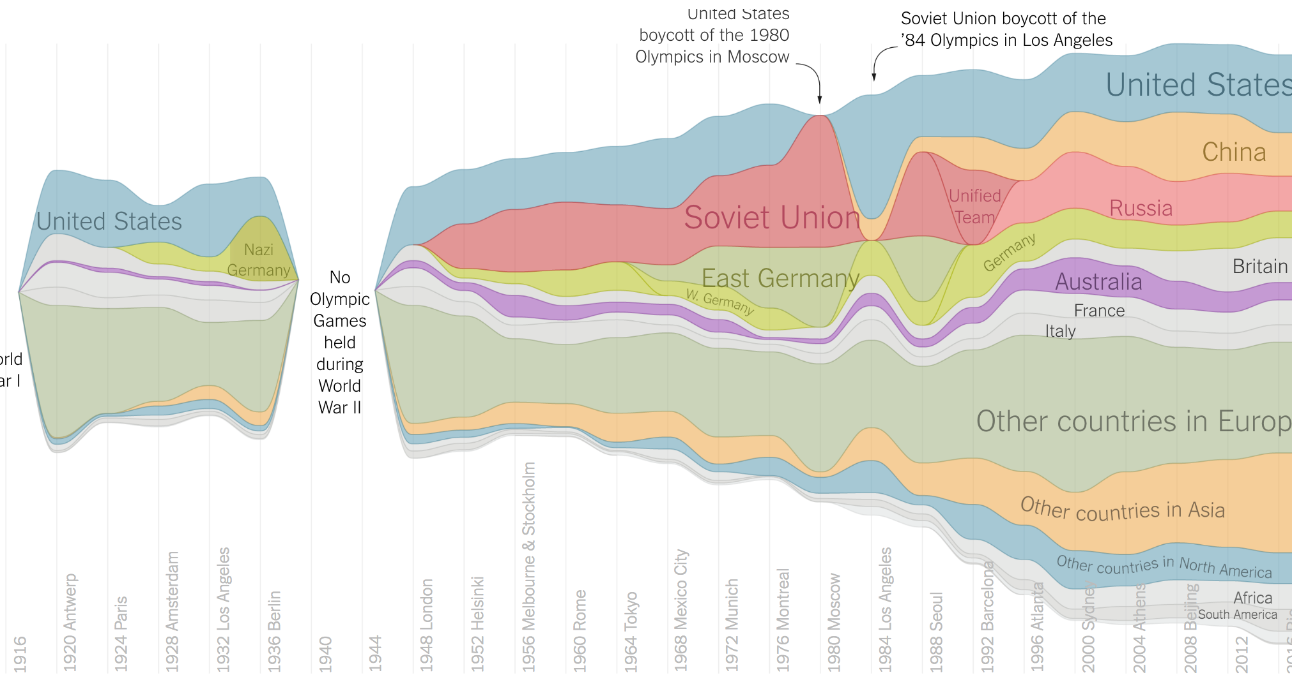
Olympic Medals
7
https://www.nytimes.com/interactive/2016/08/08/sports/olympics/history-olympic-dominance-charts.html

Slide 10
Netflix Prize I
Recommender systems: predict a user’s rating of an item
Netflix Prize: $1MM to the first team that beats our in-house engine by 10%
Happened after about three years
Model was never used by Netflix for a variety of reasons
Out of date (DVDs vs streaming)
Too complicated / not interpretable
 | Twilight | Wall-E | Twilight II | Furious 7
User 1 | +1 | -1 | +1 | ?
User 2 | +1 | -1 | ? | ?
User 3 | -1 | +1 | -1 | +1
<number>

Slide 11
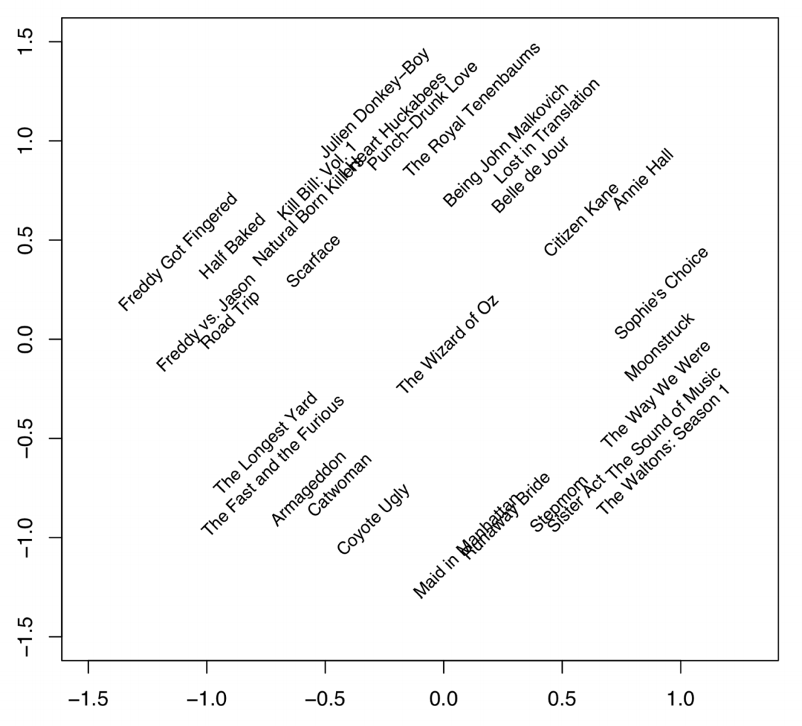
Netflix Prize II
Frat/Gross-Out Comedy
Critically-Acclaimed/Strong Female Lead
Artsy
Latent factors model:
Identify factors with max discrimination between movies
Latent factor 1
BB
<number>
Latent factor 2
Image courtesy of Christopher Volinsky

Slide 12
Netflix Prize III
Netflix initially planned a follow-up competition
In 2007, UT Austin managed to deanonymize portions of the original released (anonymized) Netflix dataset:
????????????
Matched rating against those made publicly on IMDb
Why could this be bad?
2009—2010, four Netflix users filed a class-action lawsuit against Netflix over
<number>

Slide 13
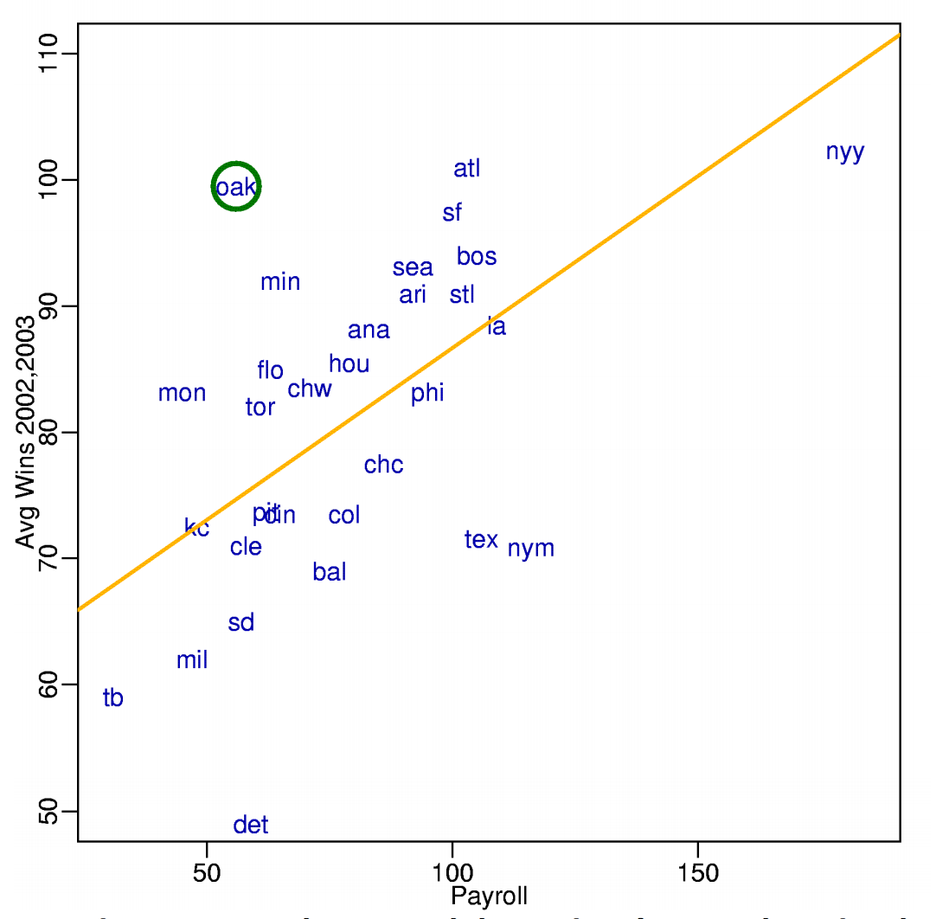
MoneyBall
Baseball teams drafted rookie players primarily based on human scouts’ opinions of their talents
Paul DePodesta, data scientist du jour, convinces the {bad, poor} Oakland Athletics to use a quantitative aka sabermetric approach to hiring
(Spoiler: Red Sox offer Brand a job, he says no, they take a sabermetric approach and win the World Series.)
(Spoiler #2: DePodesta is now GM for the Browns, who are extremely bad right now. We’ll see what happens!)
<number>
Notes:
“Sabermetrics” = “SABR” = “Society for American Baseball Research”
Peter Brand = name of character in the movie, actual name is Paul DePodesta
<number>

Slide 14
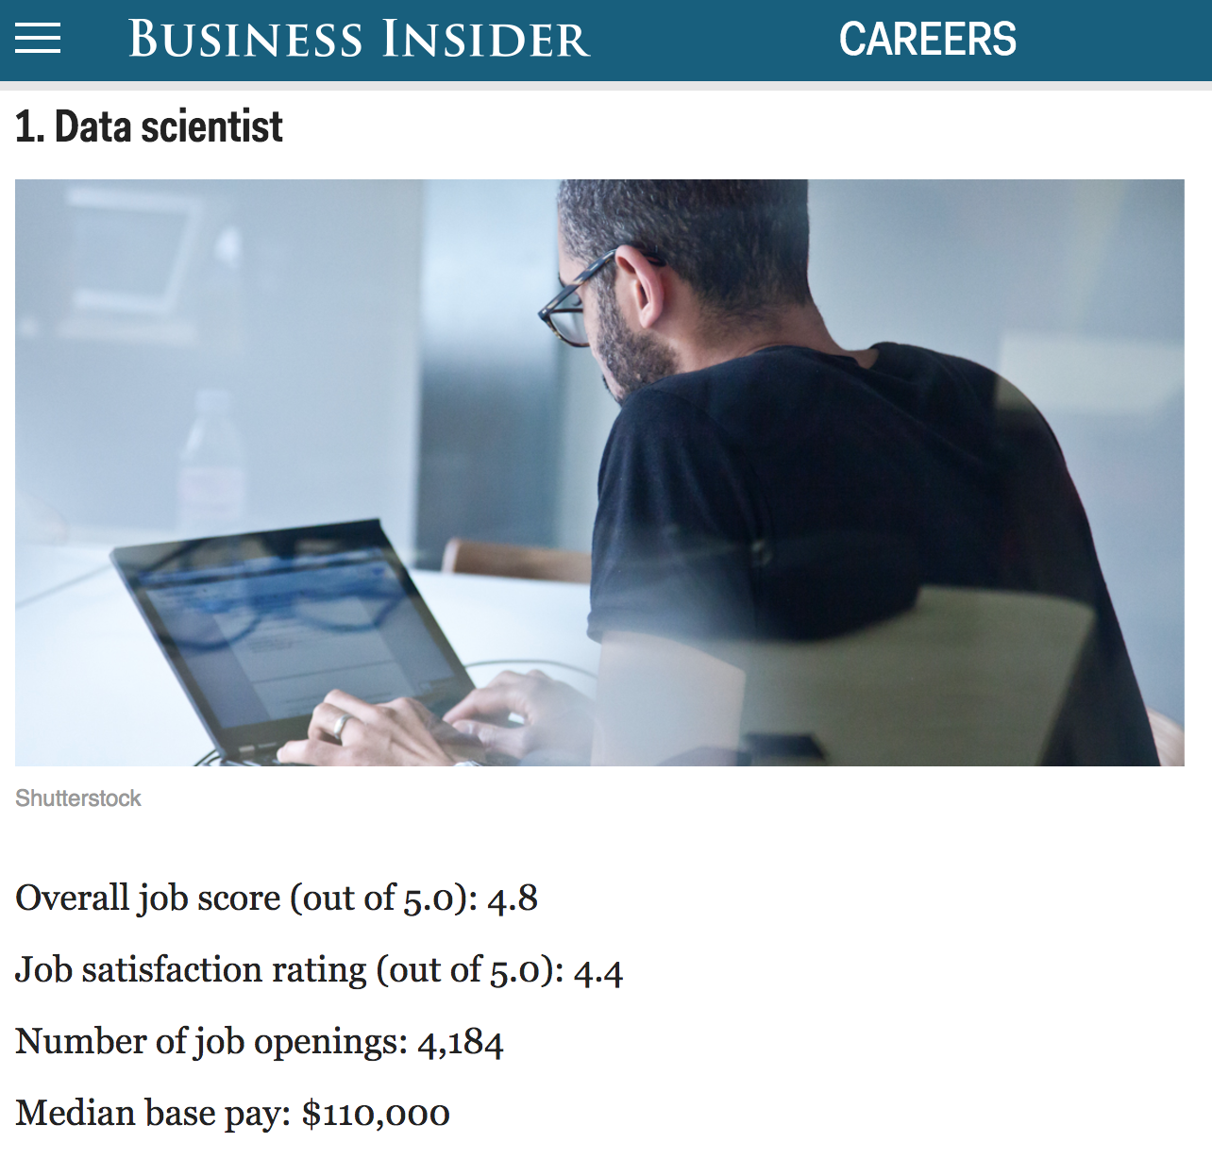
<number>
http://www.businessinsider.com/best-jobs-in-america-in-2017-2017-1/

Slide 15
Up Next … Scraping Data With Python
<number>
Notes:
<number>

Slide 16
The Data Lifecycle
Data collection
Data processing
Exploratory analysis
&
Data viz
Analysis, hypothesis testing, & ML
Insight & Policy Decision
<number>
Notes:
<number>

Slide 17
(The Rest of) Today’s Lecture
Data collection
Data processing
Exploratory analysis
&
Data viz
Analysis, hypothesis testing, & ML
Insight & Policy Decision
<number>
Notes:
<number>

Slide 18
But first, snakes!
Python is an interpreted, dynamically-typed, high-level, garbage-collected, object-oriented-functional-imperative, and widely used scripting language.
Interpreted: instructions executed without being compiled into (virtual) machine instructions*
Dynamically-typed: verifies type safety at runtime
High-level: abstracted away from the raw metal and kernel
Garbage-collected: memory management is automated
OOFI: you can do bits of OO, F, and I programming
Not the point of this class!
Python is fast (developer time), intuitive, and used in industry!
<number>
*you can compile Python source, but it’s not required

Slide 19
The Zen of Python
Beautiful is better than ugly.
Explicit is better than implicit.
Simple is better than complex.
Complex is better than complicated.
Flat is better than nested.
Sparse is better than dense.
Readability counts.
Special cases aren't special enough to break the rules …
… although practicality beats purity.
Errors should never pass silently …
… unless explicitly silenced.
<number>
Thanks: SDSMT ACM/LUG

Slide 20
Literate Programming
Literate code contains in one document:
the source code;
text explanation of the code; and
the end result of running the code.
Basic idea: present code in the order that logic and flow of human thoughts demand, not the machine-needed ordering
Necessary for data science!
Many choices made need textual explanation, ditto results.
Stuff you’ll be using in Project 0 (and beyond)!
<number>

Slide 21
Jupyter Project
Started as iPython Notebooks, a web-based frontend to the iPython Shell
Notebook functionality separated out a few years ago
Now supports over 40 languages/kernels
Notebooks can be shared easily
Can leverage big data tools like Spark
Apache Zeppelin:
https://www.linkedin.com/pulse/comprehensive-comparison-jupyter-vs-zeppelin-hoc-q-phan-mba-
Several others including RStudio (specific to R)
<number>

Slide 22
10-minute Python primer
Define a function:
Python is whitespace-delimited
Define a function that returns a tuple:
def my_func(x, y):
if x > y:
return x
else:
return y
def my_func(x, y):
return (x-1, y+2)
(a, b) = my_func(1, 2)
<number>
a = 0; b = 4

Slide 23
Useful Built-in Functions: Counting and Iterating
len: returns the number of items of an enumerable object
range: returns an iterable object
enumerate: returns iterable tuple (index, element) of a list
https://docs.python.org/3/library/functions.html
len( [‘c’, ‘m’, ‘s’, ‘c’, 3, 2, 0] )
7
list( range(10) )
[0, 1, 2, 3, 4, 5, 6, 7, 8, 9]
enumerate( [“311”, “320”, “330”] )
[(0, “311”), (1, “320”), (2, “330”)]
<number>
Notes:
do demo
<number>

Slide 24
Useful Built-In Functions: Map and Filter
map: apply a function to a sequence or iterable
filter: returns a list* of elements for which a predicate is true
We’ll go over in much greater depth with pandas/numpy.
arr = [1, 2, 3, 4, 5]
map(lambda x: x**2, arr)
[1, 4, 9, 16, 25]
arr = [1, 2, 3, 4, 5, 6, 7]
filter(lambda x: x % 2 == 0, arr)
[2, 4, 6]
<number>
*in Python 3, returns Iterable

Slide 25
Pythonic Programming
Basic iteration over an array in Java:
Direct translation into Python:
A more “Pythonic” way of iterating:
int[] arr = new int[10];
for(int idx=0; idx<arr.length; ++idx) {
System.out.println( arr[idx] );
}
idx = 0
while idx < len(arr):
print( arr[idx] ); idx += 1
for element in arr:
print( element )
<number>

Slide 26
List comprehensions
Construct sets like a mathematician!
P = { 1, 2, 4, 8, 16, …, 2¹⁶ }
E = { x | x in ℕ and x is odd and x < 1000 }
Construct lists like a mathematician who codes!
Very similar to map, but:
You’ll see these way more than map in the wild
Many people consider map/filter not “pythonic”
They can perform differently (map is “lazier”)
P = [ 2**x for x in range(17) ]
E = [ x for x in range(1000) if x % 2 != 0 ]
<number>

Slide 27
Exceptions
Syntactically correct statement throws an exception:
tweepy (Python Twitter API) returns “Rate limit exceeded”
sqlite (a file-based database) returns IntegrityError
print('Python', python_version())
try:
cause_a_NameError
except NameError as err:
print(err, '-> some extra text')
<number>

Slide 28
Python 2 vs 3
Python 3 is intentionally backwards incompatible
(But not that incompatible)
Biggest changes that matter for us:
print “statement” → print(“function”)
1/2 = 0 → 1/2 = 0.5 and 1//2 = 0
ASCII str default → default Unicode
Namespace ambiguity fixed:
i = 1
[i for i in range(5)]
print(i) # ????????
<number>
Notes:
Prints “4” in Python 2 and “1” (i.e., unchanged because the list comprehension scope is dead) in Python 3.
<number>

Slide 29
To any Curmudgeons …
If you’re going to use Python 2 anyway, use the _future_ module:
Python 3 introduces features that will throw runtime errors in Python 2 (e.g., with statements)
_future_ module incrementally brings 3 functionality into 2
https://docs.python.org/2/library/__future__.html
from _future_ import division
from _future_ import print_function
from _future_ import please_just_use_python_3
<number>

Slide 30
So, How does Import Work?
Python code is stored in module – simply put, a file full of Python code
A package is a directory (tree) full of modules that also contains a file called __init.py__
Packages let you structure Python’s module namespace
E.g., X.Y is a submodule Y in a package named X
For one module to gain access to code in another module, it must import it
<number>

Slide 31
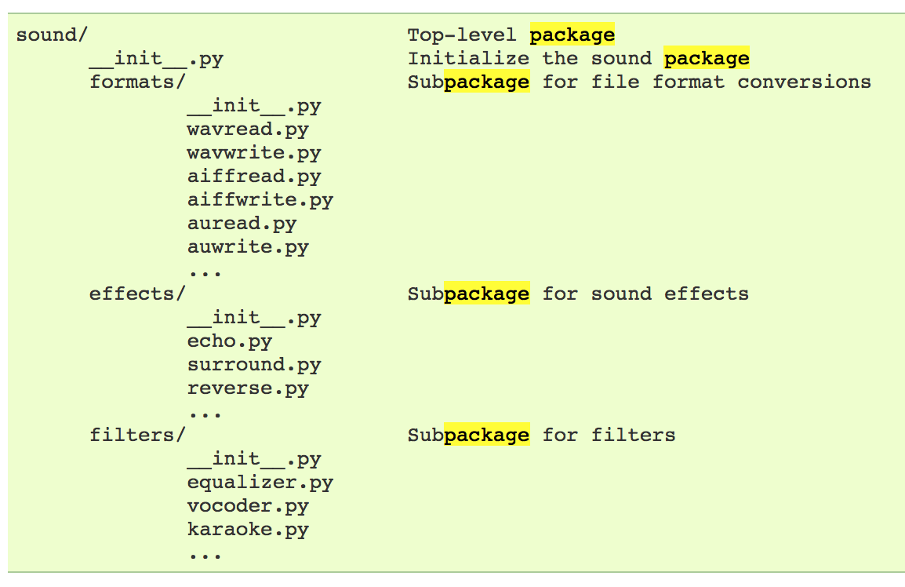
Example
# Load (sub)module sound.effects.echo
import sound.effects.echo
# Must use full name to reference echo functions
sound.effects.echo.echofilter(input, output, delay=0.7)
<number>
https://docs.python.org/2/tutorial/modules.html

Slide 32
Example
# Load (sub)module sound.effects.echo
import sound.effects.echo
# Must use full name to reference echo functions
sound.effects.echo.echofilter(input, output, delay=0.7)
# Load (sub)module sound.effects.echo
from sound.effects import echo
# No longer need the package prefix for functions in echo
echo.echofilter(input, output, delay=0.7)
# Load a specific function directly
from sound.effects.echo import echofilter
# Can now use that function with no prefix
echofilter(input, output, delay=0.7)
<number>
https://docs.python.org/2/tutorial/modules.html

Slide 33
Python vS R (For Data Scientists)
There is no right answer here!
Python is a “full” programming language – easier to integrate with systems in the field
R has a more mature set of pure stats libraries …
… but Python is catching up quickly …
… and is already ahead specifically for ML.
You will see Python more in the tech industry.
<number>

Slide 34
Extra resources
Plenty of tutorials on the web:
https://www.learnpython.org/
Work through Project 0, which will take you through some baby steps with Python and the Pandas library:
(We’ll also post some more readings soon.)
Come (virtually!) hang out at office hours:
All office hours will be on the website/Piazza by early next week.
Will have coverage MTWThF.
<number>

Slide 35
<number>

